Slide 1
Model Reduction Using Machine Learning Methods with Domain Decomposition for Fluid Flow Problems
Author: Yunzhen (Wade) Song
Supervisors: Christopher Pain, Claire Heaney

Slide 2
Contents
Background & Motivation
Algorithm
Software
Test Cases
Comparison & Discussion
Conclusion
Q&A
Notes:
Here’s the topic for today

Slide 3
Background & Motivation

Slide 4
Background & Motivation
Simulation for fluid flow problems governed by N-S equation is slow.
Reduced Order Modelling(ROM) can speed up the simulation
Faster speed could enable real-time decision making
ROM can exploit Domain Decomposition (DD) methods to increase its accuracy and further reduce the computational time for large system
Notes:
generating snapshots (solutions of a problem from your computer code)
->
compression: reducing the dimension of the problem (from number of degrees of freedom to number of POD basis functions)
->
training: fitting a surface to the reduced variables (POD coefficients) of the snapshots

Slide 5
Algorithm

Slide 6
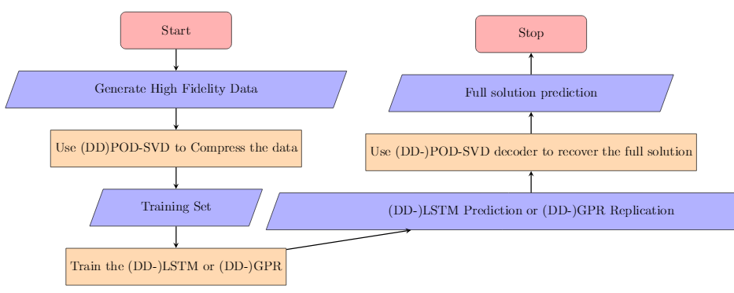
Algorithm describing the application of an example

Slide 7
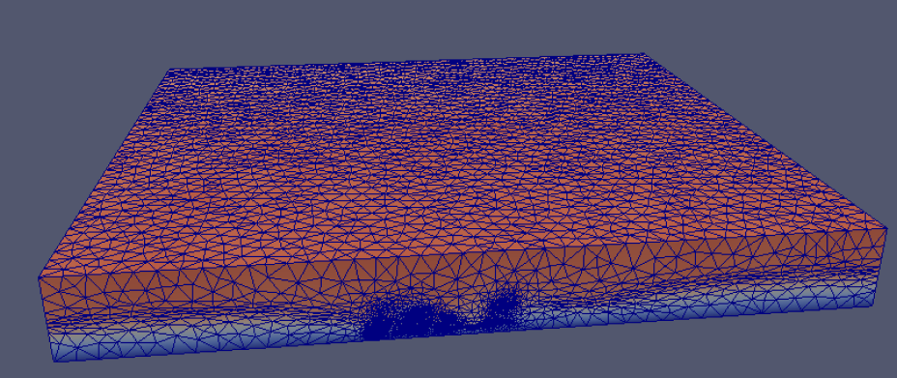
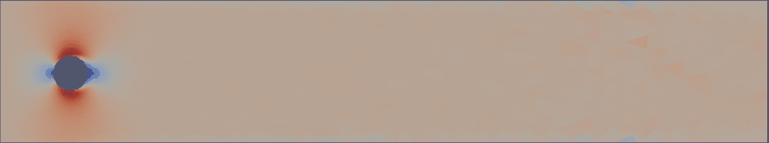
High Fidelity Data (2D & 3D Test Case)
Freedom: 11036 * 2
Freedom: 670975 * 3
HFD for 2D flow past a cylinder test case
HFD for 3D London South Bank test case

Slide 8
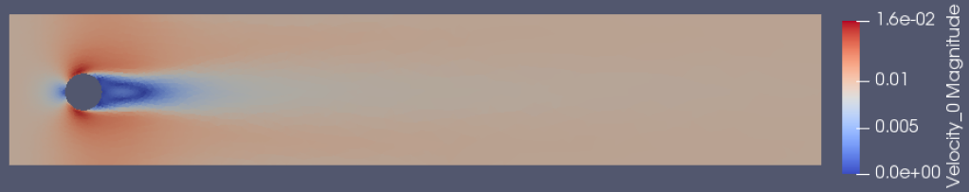
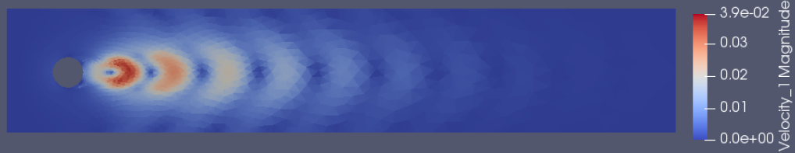
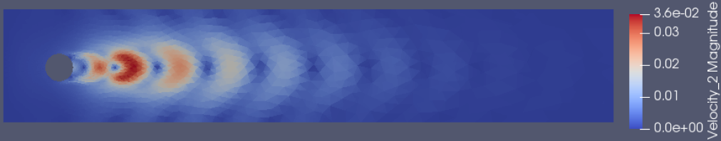
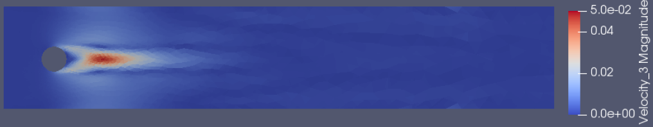
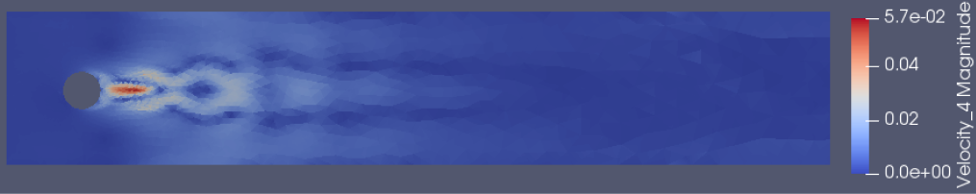
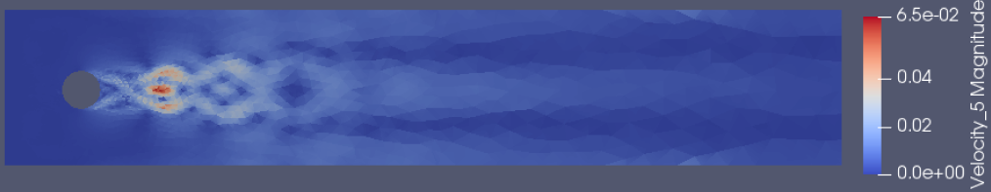
Compression: Proper Orthogonal Decomposition (POD)
6 POD basis functions for Flow Past a Cylinder

Slide 9

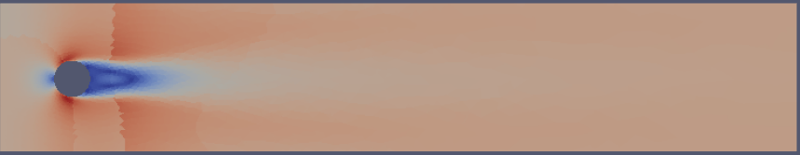
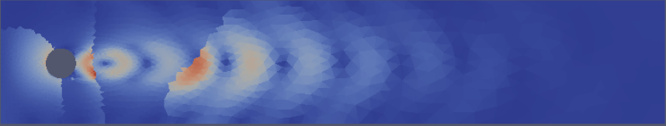
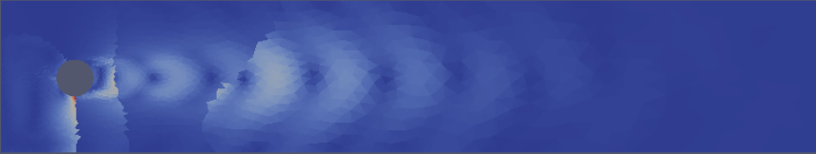
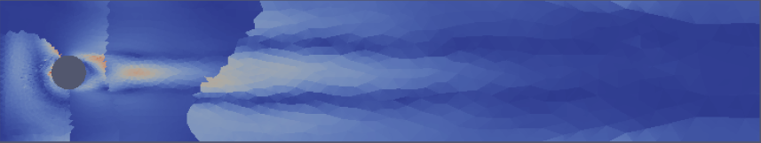
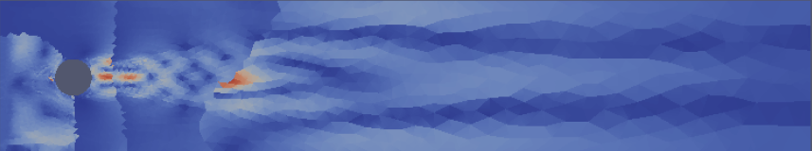
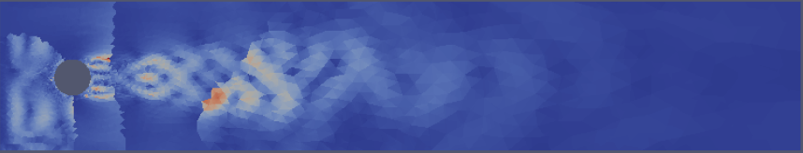
Compression: DD-POD
6 DD-POD basis functions for Flow Past a Cylinder

Slide 10
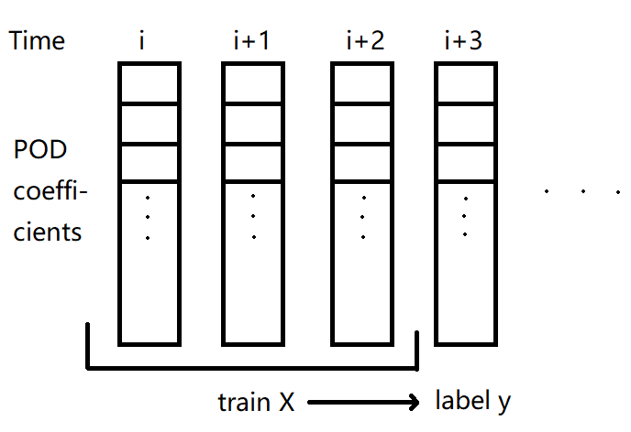
Training in Reduced Space: Long Short Term Memory (LSTM) & Gaussian Process Regression (GPR)
Each time step the LSTM takes reduced variables (e.g. from POD) from 3-time previous levels.
As for GPR, it takes reduced variable at 1-time previous levels.
The method to obtain the training data X and label y for LSTM

Slide 11
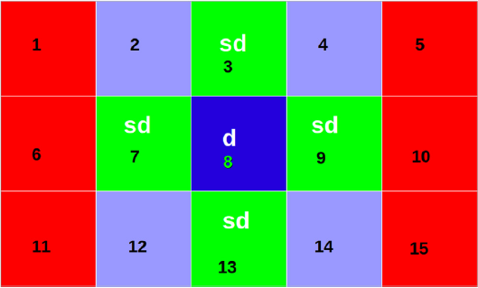
Training in Reduced Space: DD-LSTM DD-GPR
Local time step iteration
Current value and future value
Method of training and predicting DD-LSTM/GPR

Slide 12
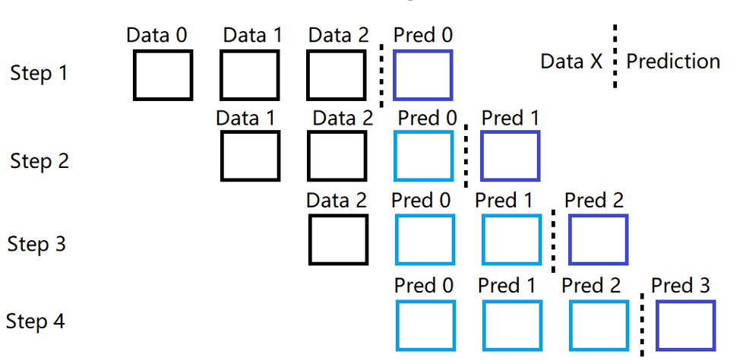
Predicting in Reduced Space
LSTM takes first 3 time steps’ reduced variables and get one prediction. The prediction will become the input of predicting further time steps’ result.
The method to obtain the training data X and label y for LSTM

Slide 13
Software

Slide 14
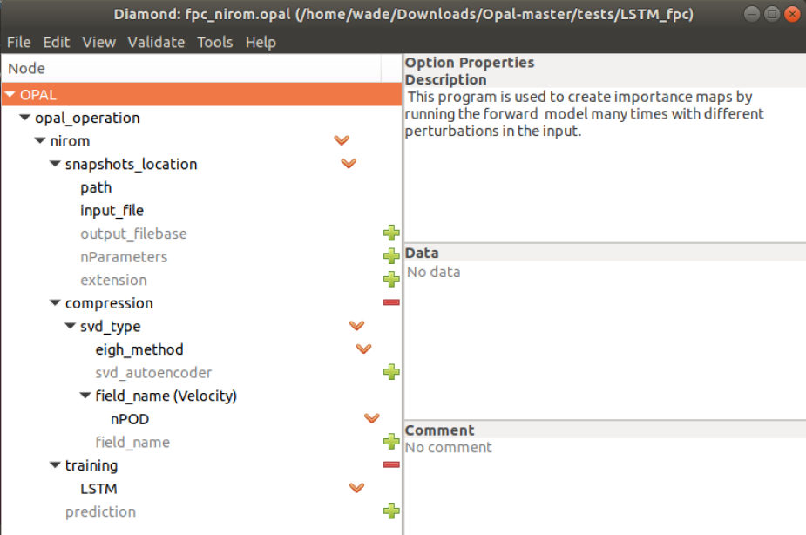
Software
System: Linux
Packages: sklearn, pytorch, numpy, IC-Ferst
Main application software: Opal
ROM: LSTM, GPR, DD-LSTM, DD-GPR
User interface including all settings

Slide 15
Test cases

Slide 16
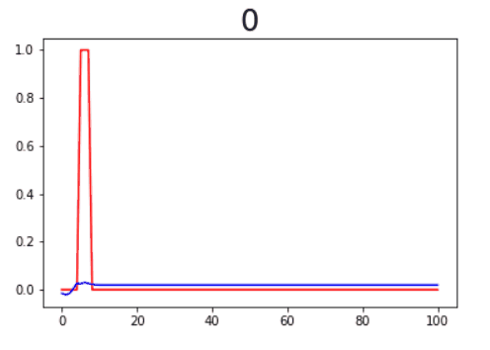
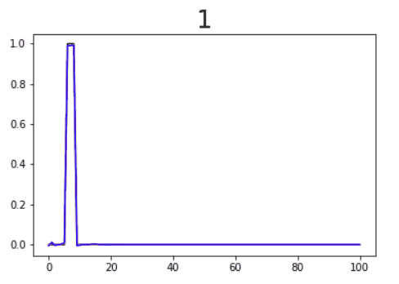
Test case 1: 1D Square Wave using LSTM
The process to train 1D square wave by LSTM
(Red line is the label, blue line is the prediction)
Predicting 1D square wave by LSTM
(Red line is the label, blue line is the prediction)
Notes:
Pred is much faster than training

Slide 17
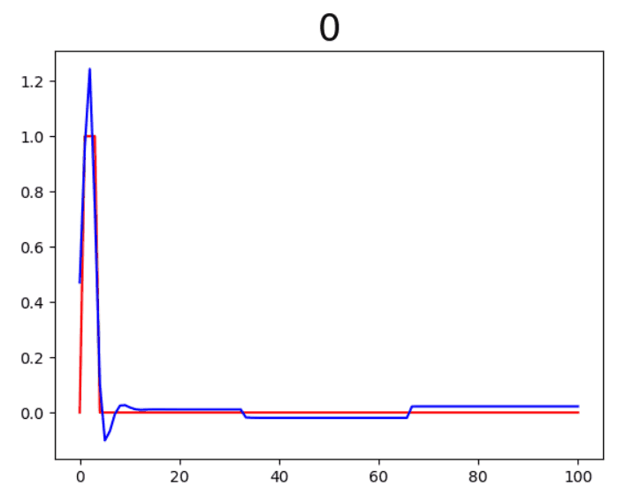
Test case 2: 1D Square Wave using DD-LSTM
3 subdomains
Each subdomain takes the current value of itself and prediction value from its neighbors for local time iteration
Training process of 1D square wave by DD-LSTM

Slide 18
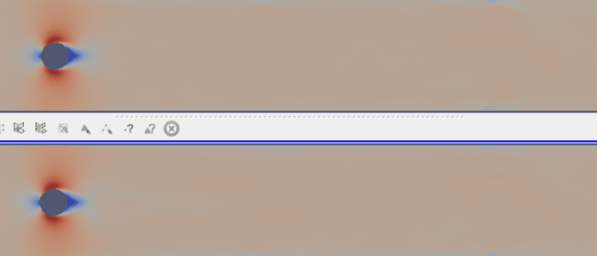
Test case 3: 2D Flow Past a Cylinder (FPC) using LSTM
Training data (Original FPC data)
Using POD to compress, 10 POD basis functions
Using 180 time steps data to train the model
Predict 200 time steps (from the beginning)
Prediction of 2D FPC by LSTM

Slide 19
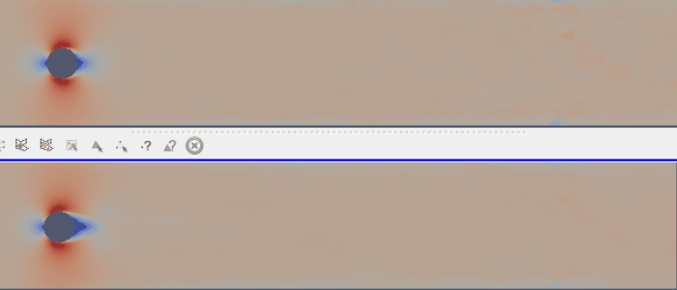
Test case 4: 2D FPC using GPR
Training data (Original FPC data)
Using POD to compress, 10 POD basis functions
Using 180 time steps data to train the model
Predict 200 time steps
Prediction of 2D FPC by GPR

Slide 20

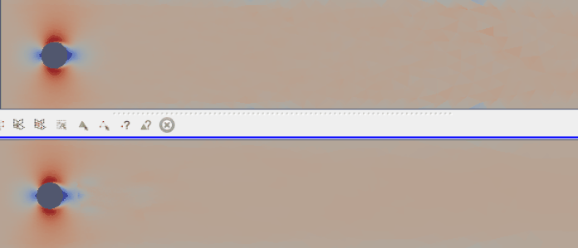
Test case 5: 2D FPC using DD-GPR
32 subdomains
Balance the weight of nodes in each subdomains.
Weight can be decided by Reynold stress.
Training data (Original FPC data)
Prediction of 2D FPC by DD-GPR

Slide 21
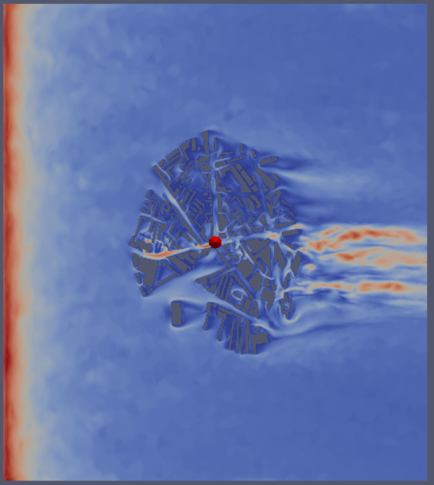
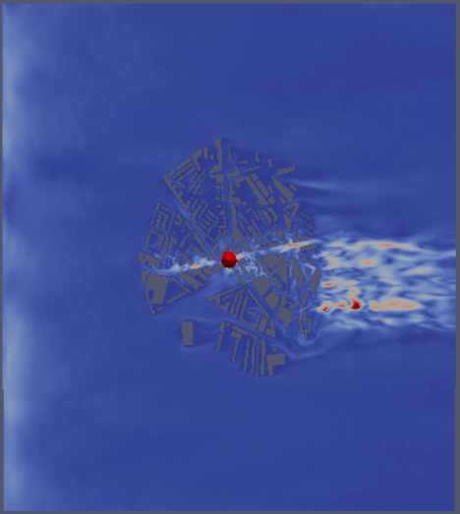
Test case 6: 3D London South Bank University(LSBU) by LSTM
Using POD to compress, using 400 POD basis functions
In a cutting plane perpendicular to Z axis, Z = 10m
Result at 100 time step
HFM of 3D test case
Prediction by LSTM for 3D test case

Slide 22
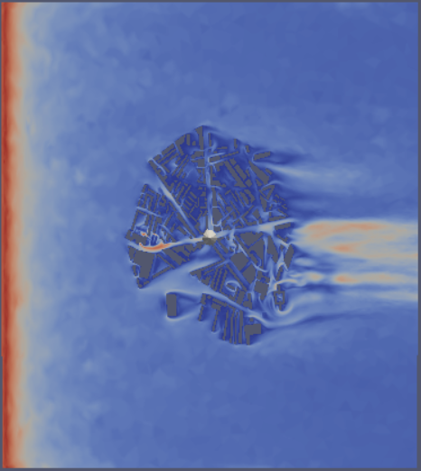
Test case 7: 3D LSBU by GPR (10 PODs)
Using POD to compress, using 10 POD basis functions
In a cutting plane perpendicular to Z axis, Z = 10m
Result at 100 time step
HFM of 3D test case
Prediction by GPR for 3D test case

Slide 23
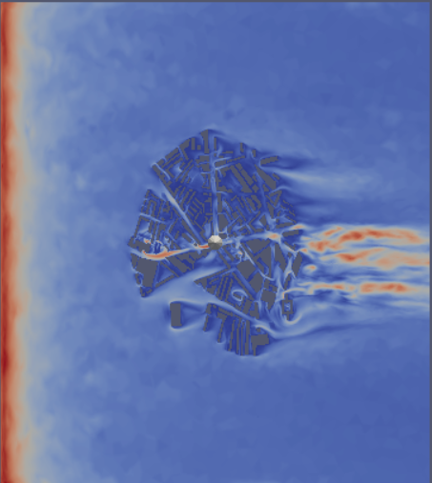
Test case 8: 3D LSBU by GPR (400 PODs)
Using POD to compress, using 400 POD basis functions
Much better!
In a cutting plane perpendicular to Z axis, Z = 10m
Result at 100 time step
HFM of 3D test case
Prediction by GPR for 3D test case

Slide 24
Comparison & Discussion

Slide 25
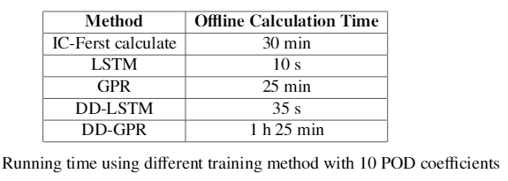
Comparison & Discussion: Speed comparison
Time include (Read in data, compression, training, predicting, write to file)
LSTM is the fastest in speed.

Slide 26
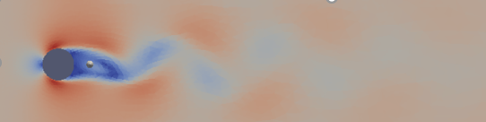
Comparison & Discussion: Accuracy
Compare the probability density function (by frequency) of the HFM and the prediction.
Data comes from a fix point at the same coordinate.
The point’s coordinate is x = 0.3, y = 0.2
Probe the velocity data of this point

Slide 27
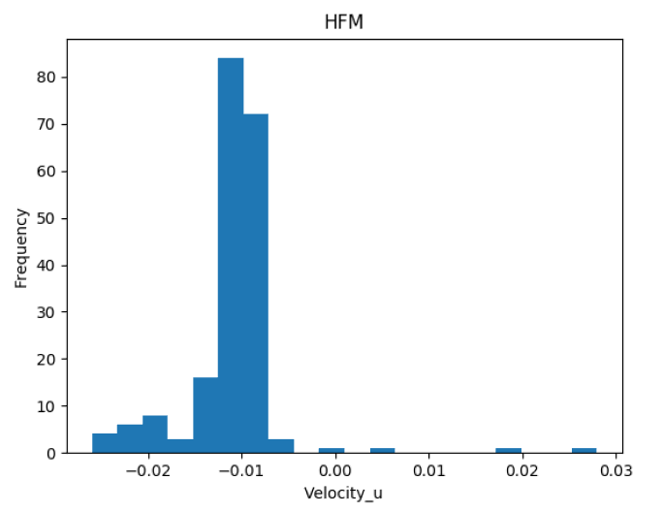
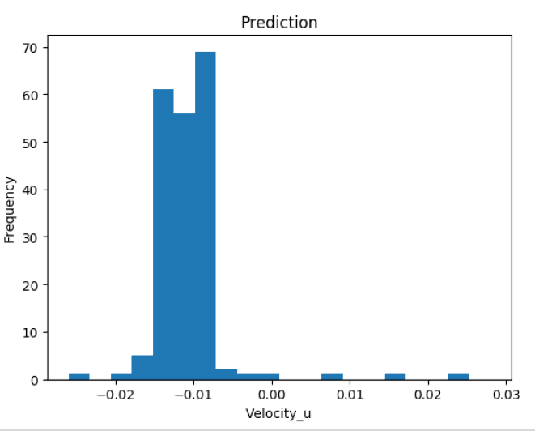
Comparison & Discussion: Accuracy of 2D LSTM
Frequency distribution of HFM’s velocity in u direction
Frequency distribution of Prediction’s velocity in u direction

Slide 28
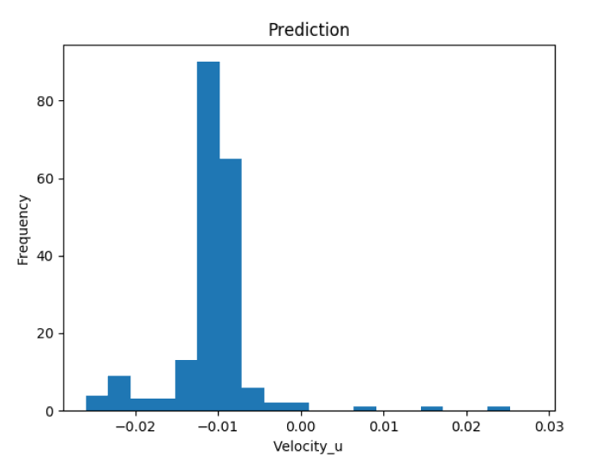
Comparison & Discussion: Accuracy of 2D GPR
Frequency distribution of HFM’s velocity in u direction
Frequency distribution of Prediction’s velocity in u direction

Slide 29
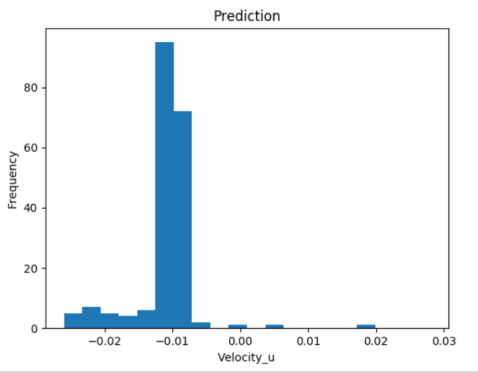
Comparison & Discussion: Accuracy of 2D DD-GPR
Frequency distribution of HFM’s velocity in u direction
Frequency distribution of Prediction’s velocity in u direction

Slide 30
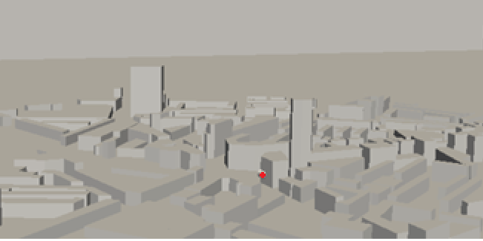
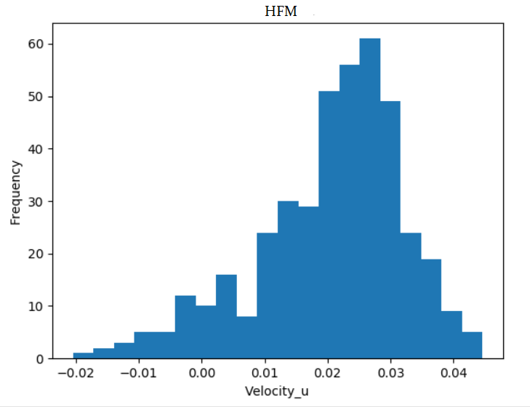
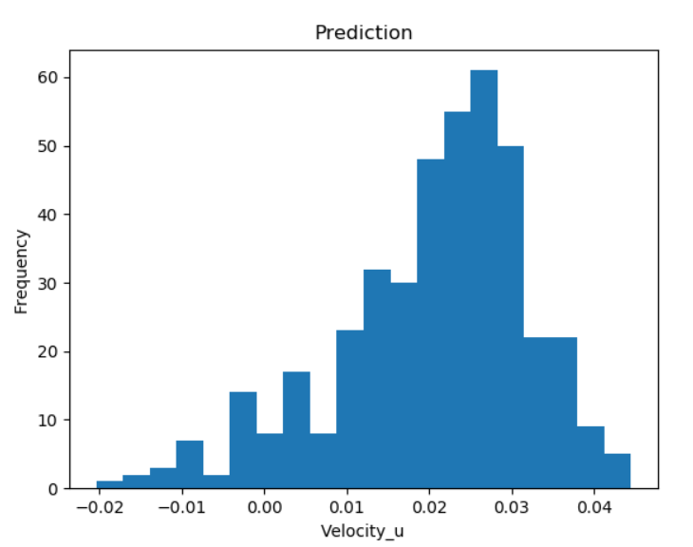
Comparison & Discussion: Accuracy of 3D GPR
Point for probing velocity
Frequency distribution of
HFM’s velocity in u direction
Frequency distribution of Prediction’s
velocity in u direction with 400 POD

Slide 31
Conclusion

Slide 32
Conclusion
Using ROM for fluid flow problems will effectively speed up the prediction process.
LSTM's offline training has the advantage in speed.
Both LSTM and GPR can learn the features of fluid flow in reduced space.

Slide 33
Q & A

